Slide 1
History: ROC, Utility, and indifference lines
 | Positive (r_{p}=5%) | Negative (r_{n}=95%)
Positive | u_{tp}* r_{p}*TPR | u_{fp}* r_{n}*FPR
Negative | u_{fn}* r_{p}*(1-TPR) | u_{tn}* r_{n}*(1-FPR)
E(u) = u_{tp}* r_{p}*TPR + u_{fn}* r_{p}*(1-TPR) + u_{fp}* r_{n}*FPR + u_{tn}* r_{n}*(1-FPR)
E(u) = u_{tp}* r_{p}*1 + u_{fn}* r_{p}*(1-1) + u_{fp}* r_{n}*1 + u_{tn}* r_{n}*(1-1)
True positive rate
E(u) = u_{tp}* r_{p} + u_{fp}* r_{n}
E(u) = 100*5 + 2*95
E(u) = 690
690 = 100*5*TPR + 200* 5*(1-TPR) + 2* 95*FPR + 1*95*(1-FPR)
False positive rate
Red line: act on every case.
Yellow line: ignore every case.
Green line: current rule
Blue line: rule from a threshold on the model’s output
Notes:
Red line is for d=1, which means act on every case.
Yellow line is for d=0, which means ignore every case.

Slide 2
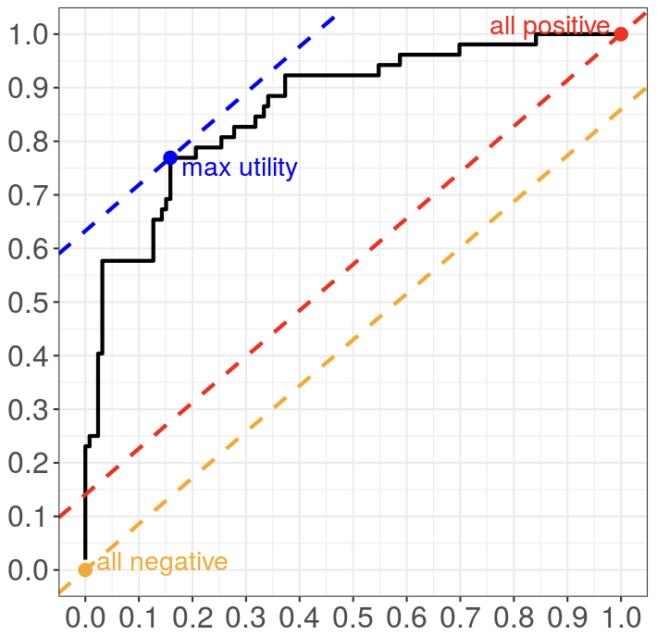
Is there utility, given cost and benefit of actions?
 | Positive (r_{p}=?%) | Negative (r_{n}=?%)
Positive | $28,613 * r_{p}*TPR | $14,970 * r_{n}*FPR
Negative | $37,085 * r_{p}*(1-TPR) | $11,646* r_{n}*(1-FPR)
True positive rate
Spending $3,324 to save $8,472
False positive rate
Notes:
FN = 37,085 = Gade et al. original value of 21252 * inflation multiplier of 1.745
TP = 28,613 = Gade et al. Net savings of 4855 * inflation multiplier, subtracted from 37,085
FP = 14,970 = 11,646 + inflation adjusted cost of intervention (3,324)
TN = 11,646 = Per capita spend in US, 2018, Peterson-Kaiser
U (TP – FN) = 28,613 – 37,085 = -8,472
Spending $3,324 to save $8,472

